Slide 1
Cloud Deployment and Service Models
Reference: Distributed and Cloud Computing K. Hwang, G. Fox and J. Dongarra

Slide 2
Overview
Cloud Deployment Models
Public Cloud
Private Cloud
Hybrid Cloud
Community Cloud
Cloud Service Models
Infra-structure as a Service (IaaS)
Platform as a Service (PaaS)
Software as a Service (SaaS)
Cloud Computing Challenges

Slide 3

Is Cloud environment centralized or distributed ???

Slide 4
Some argue as Centralized
And
Some argue as Distributed

Slide 5
Centralized and Distributed computing
Cloud computing is indeed practicing distributed parallel computing over datacenter resources.
All computations associated with a single cloud application are still distributed to many servers in multiple datacenters.
Commercial cloud providers such as Amazon, Google and Microsoft created their platforms to be distributed geographically.
These centers may have to communicate with each other around the globe

Slide 6
Deployment Models in Cloud
There are 4 Deployment models
1. Public Cloud
2. Private Cloud
3. Hybrid Cloud
4 .Community Cloud

Slide 7
Public Cloud
Public cloud is built over the Internet, which can be accessed by any user who has paid for the service.
Public clouds are owned by service providers.
They are accessed by subscription.
Commercial companies have built public clouds. They are
Google App Engine,
Amazon AWS,
Microsoft Azure,
IBMBlue Cloud, and
Salesforce Force.com.
They offer a publicly accessible remote interface for creating and managing VM instances within their proprietary infrastructure.

Slide 8
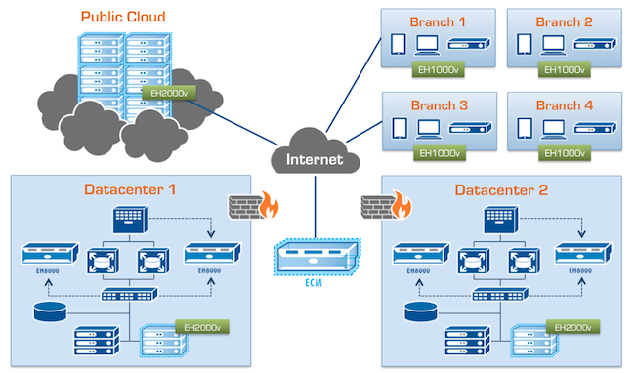
Public Cloud Diagram

Slide 9
Private Cloud
Private cloud is built within the domain of an intranet owned by a single organization.
They are client owned and managed.
Their access is limited to the owning clients and their partners.
Their deployment was not meant to sell capacity over the Internet through publicly accessible interfaces.
Private clouds give local users a flexible and agile private infrastructure to run service workloads within their administrative domains.
Problem
They may impact the cloud standardization, while retaining greater customization and organizational control.

Slide 10
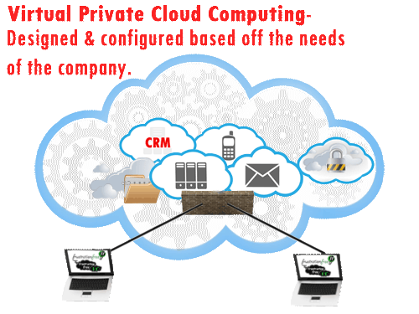
Private Cloud Diagram

Slide 11
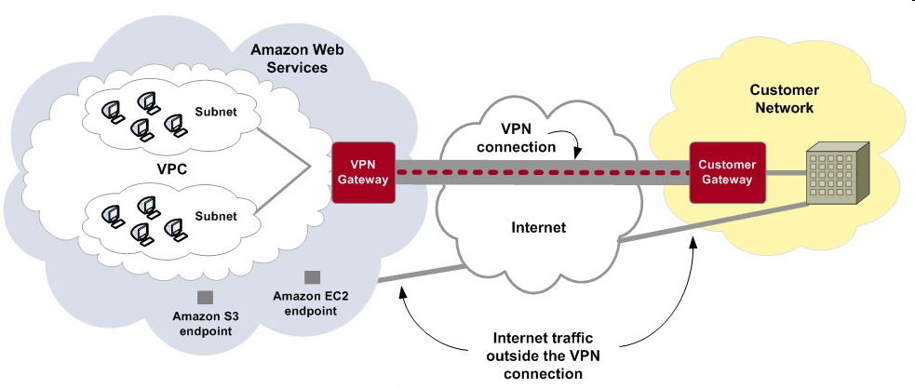
Amazon’s Private Cloud

Slide 12
Hybrid Cloud
Hybrid cloud is built with both public and private clouds
Private clouds can also support a hybrid cloud model by supplementing local infrastructure with computing capacity from an external public cloud.
For example, the Research compute cloud (RC2) is a private cloud built by IBM.
The RC2 interconnects the computing and IT resources at 8 IBM Research Centers scattered in US, Europe, and Asia.

Slide 13
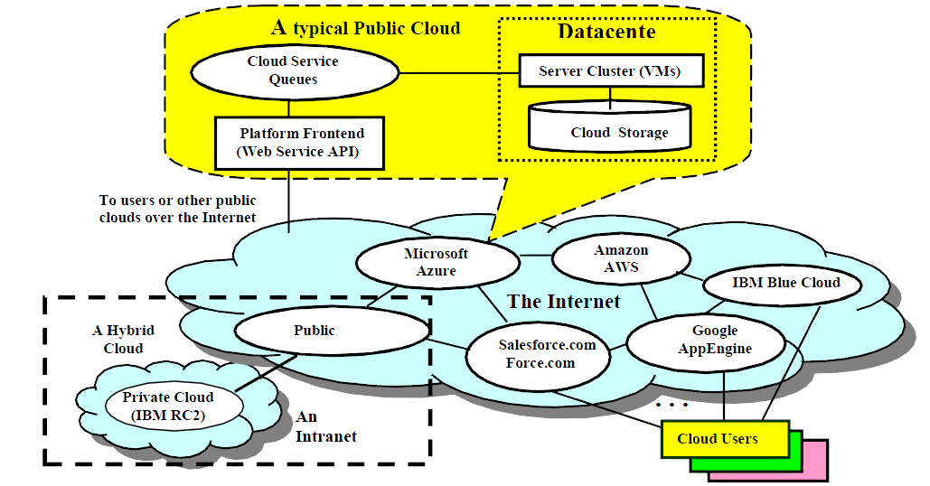
Public Clouds vs. Private Clouds
Public, private, and hybrid clouds over the Internet and intranets. The callout box shows the architecture of a typical public cloud. A private cloud is built within an intranet. A hybrid cloud involves both public and private clouds in its range. Users access the clouds from a web browser or through an special application programming interface (API).

Slide 14
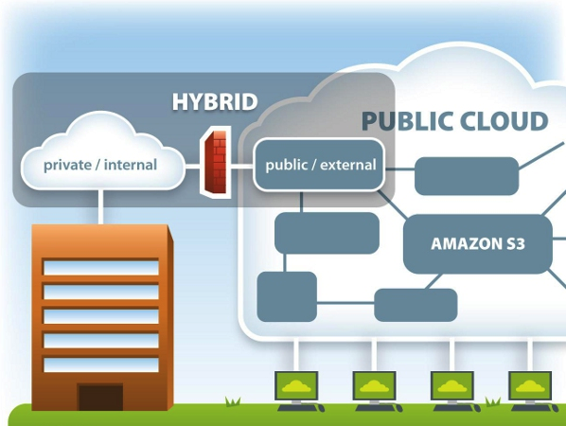
Private, Public and Hybrid Cloud

Slide 15
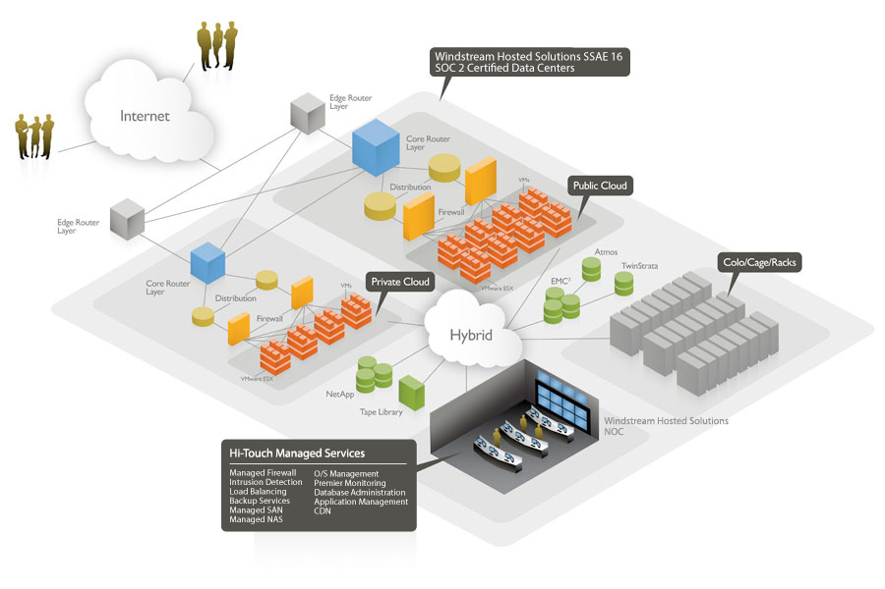
Private, Public and Hybrid Cloud

Slide 16
Community Cloud
Community cloud: Cloud infra-structure is shared by several organizations or community of people who have same vision, security requirements and policy.
It may be managed by an organization or third-party.

Slide 17
Summary of Cloud Deployment Models
Public clouds promotes
Standardization,
Preserves capital investigation,
Offers application flexibility.
Private clouds attempt to
Achieve customization and
Offer higher efficiency,
Resiliency, Security, and Privacy.
Hybrid clouds operates in the middle way with compromises

Slide 18
Public Clouds vs. Private Clouds
Characteristics | Public clouds | Private clouds
Technology leverage and ownership | Owned by service providers | Leverage existing IT infrastructure and personnel; owned by individual organization
Management of provisioned resources | Creating and managing VM instances within proprietary infrastructure; promote standardization, preserves capital investment, application flexibility | Client managed; achieve customization and offer higher efficiency
Workload distribution methods and loading policies | Handle workload without communication dependency; distribute data and VM resources; surge workload is off-loaded | Handle workload dynamically, but can better balance workloads; distribute data and VM resources
Security and data privacy enforcement | Publicly accessible through remote interface | Access is limited; provide pre-production testing and enforce data privacy and security policies
Example platforms | Google App Engine, Amazon AWS, Microsoft Azure | IBM RC2

Slide 19
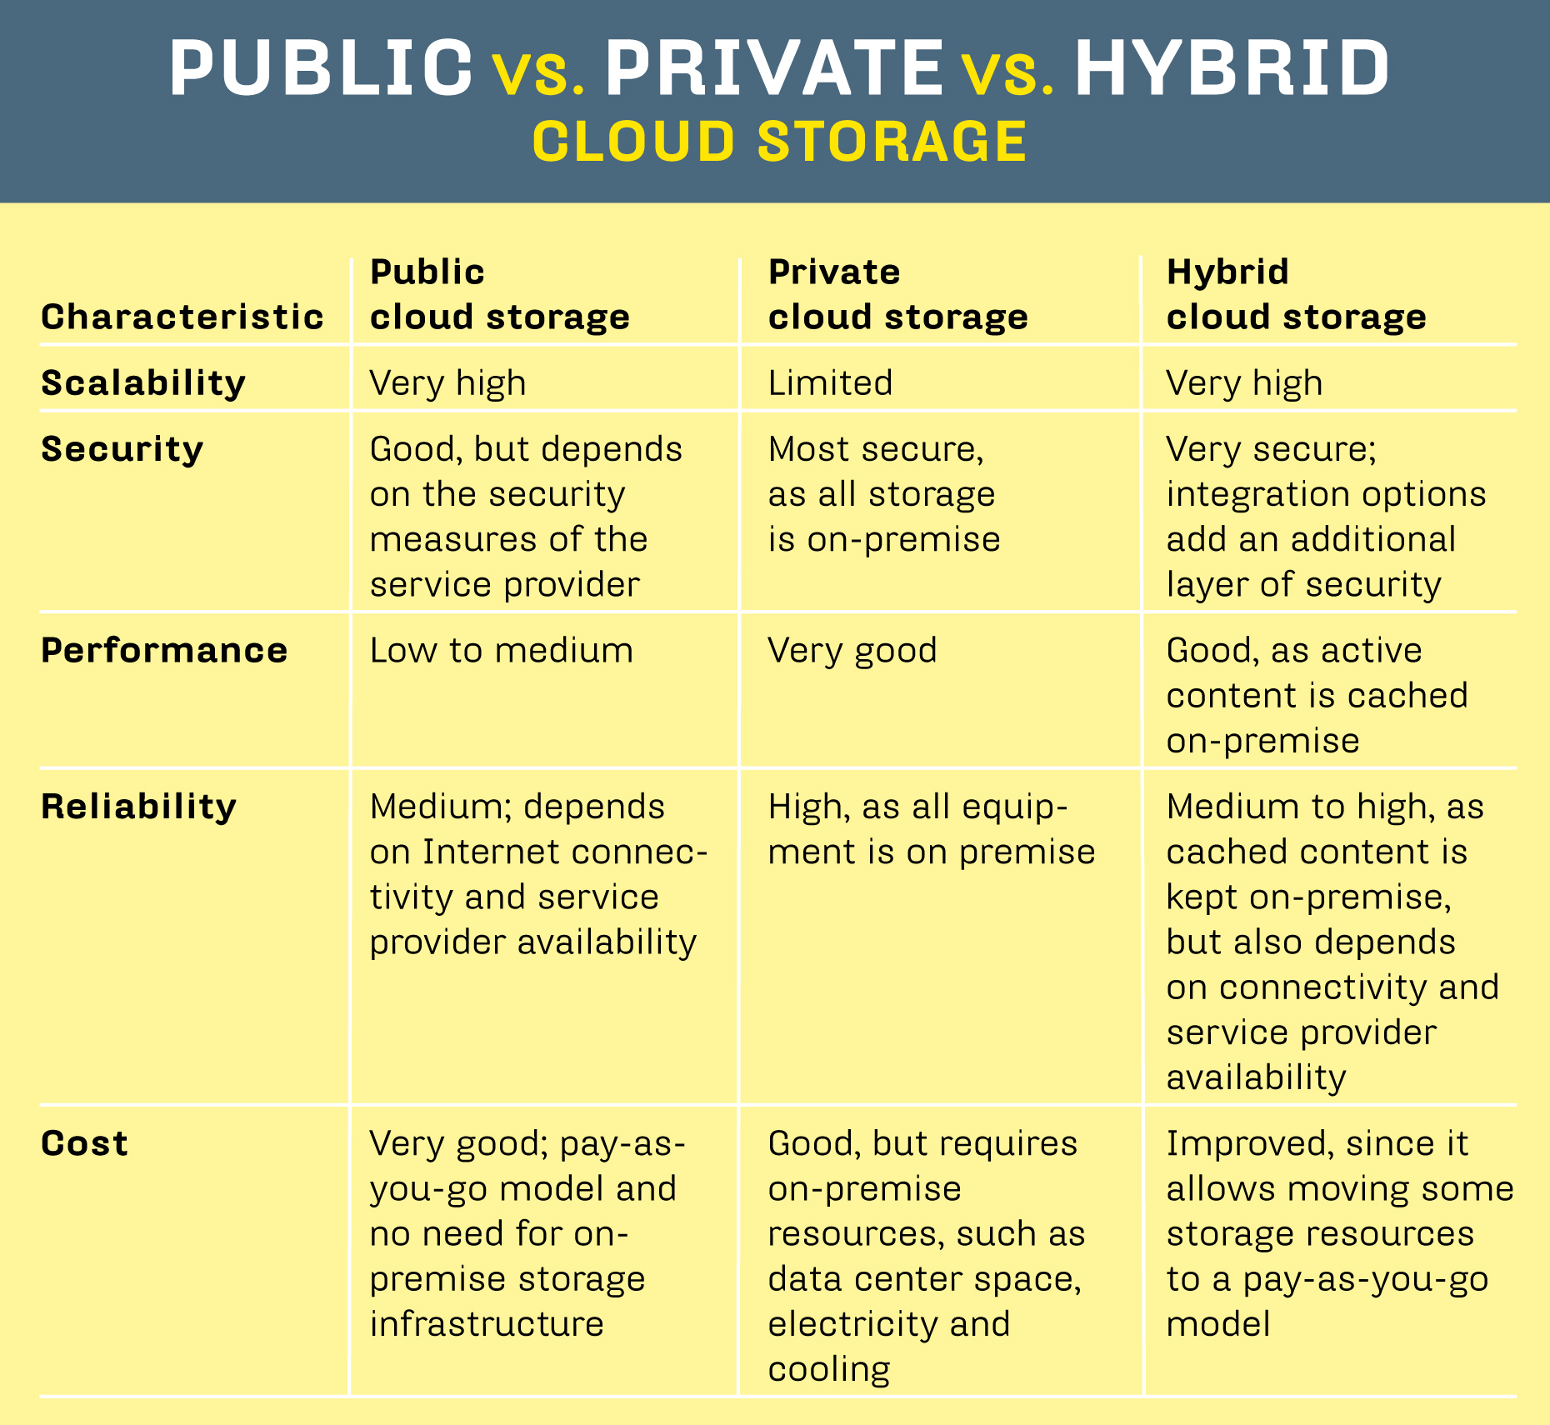

Slide 20
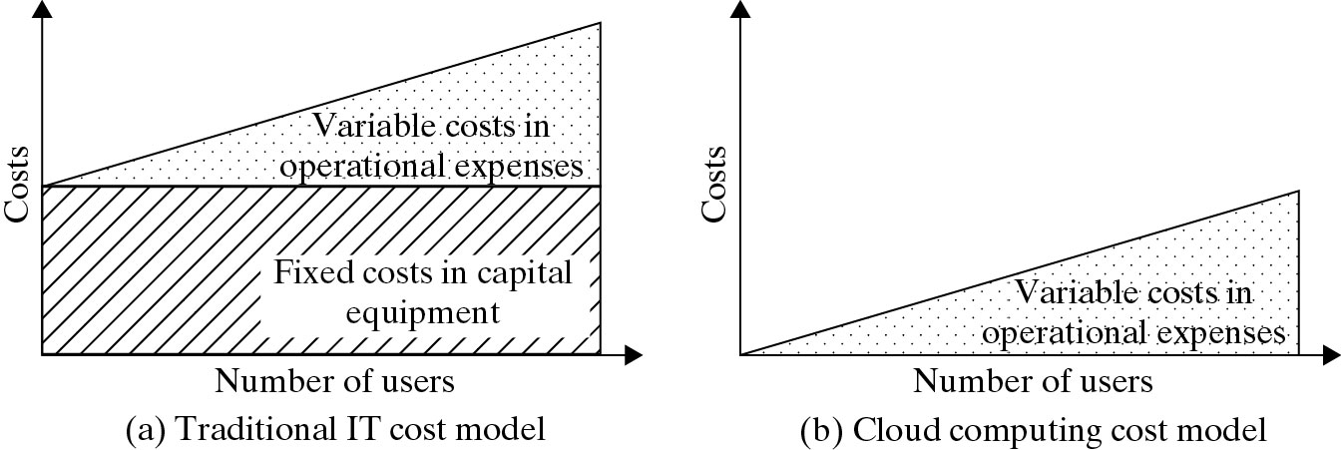
Cost-Effectiveness in Cloud Computing vs. Datacenter Utilization
(Courtesy of M. Ambrust, et al 2009)

Slide 21
Cloud Service Models
Mainly are 3 Service models
1. Infra-structure as a Service (IaaS)
2. Platform as a Service (PaaS)
3. Software as a Service (SaaS)

Slide 22
Cloud Service Models
Cloud computing delivers infrastructure, platform, and software (application) as services
Available as subscription-based services in a pay-as-you-go model to consumers.
All the three models allow the user to access the services over the Internet, relying entirely on the infrastructures of the cloud service providers
These models are offered based on various SLAs between the providers and Consumers.
The SLA for cloud computing is addressed in terms of the service availability performance and data protection and security aspects

Slide 23
Infra-structure as a Service (IaaS)
This model allows users to rent processing, storage, networks, and other resources.
The user can deploy and run the guest OS and applications.
The user does not manage or control the underlying cloud infrastructure but has control over OS, storage, deployed applications, and possibly select networking components.
This IaaS model encompasses the storage as a service, computation resource as a service, and communication resource as a service

Slide 24
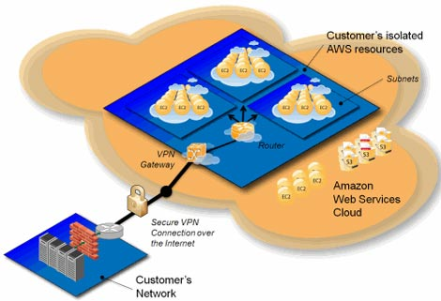
Amazon’s Virtual Private Cloud Infra-structure as a Service (IaaS)

Slide 25
Example for Infra-structure as a Service (IaaS)
Amazon’s VPC for Multiple Tenants
Virtual Private Cloud (VPC) is designed to address privacy concerns of public cloud that hamper application when sensitive data or software are involved.
VPC allows users to isolate their provisioned AWS processor, memory and storage from other users.
Auto-scaling : enables users to automatically scale their VM instances capacity up or down.
Auto-scaling ensures sufficient number of Amazon EC2 instances are provisioned to meet desired performance.
Or scale down the VM instance capacity to reduce cost when workload is reduced.

Slide 26
Amazon offers below (IaaS) Services
EC2 (Elastic compute cloud) allows users to rent virtual computers to run their own computer applications.
S3 (simple storage service) provides the object-oriented storage service for users.
EBS (Elastic block service) provides the block storage interface.
Amazon DevPay is a simple to use online billing and account management service.
MPI clusters uses hardware-assisted virtualization instead of paravirtualization.
AWS import/export allows shipping data to and from EC2.
CloudWatch monitors running instances.
Amazon CloudFront implements a content distribution network.

Slide 27
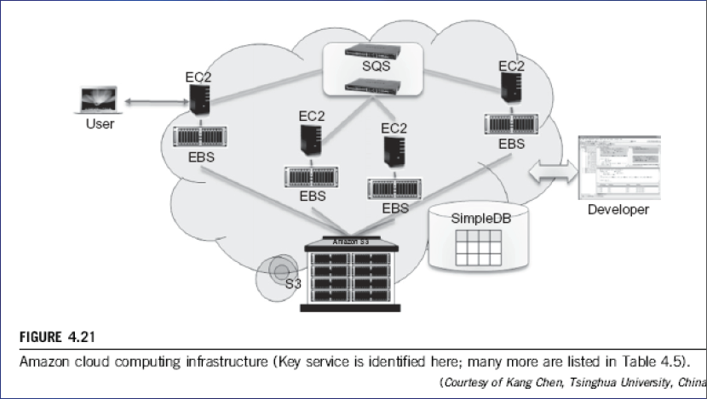
Amazon Web Services

Slide 28
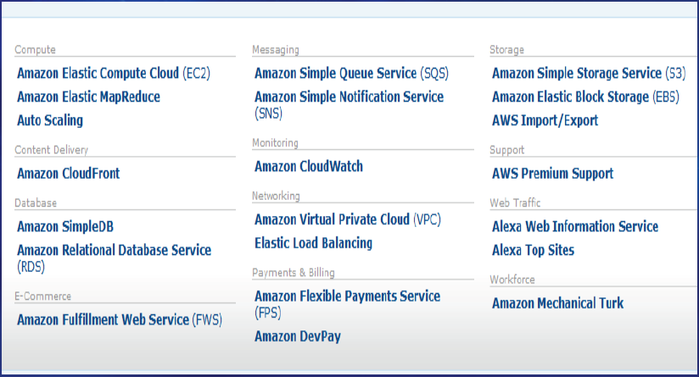
Amazon Web Services

Slide 29
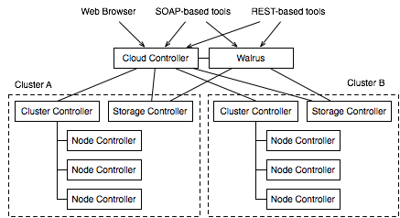
Eucalyptus Private Cloud

Slide 30
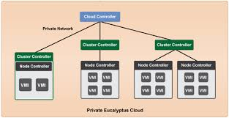
Eucalyptus Private Cloud

Slide 31
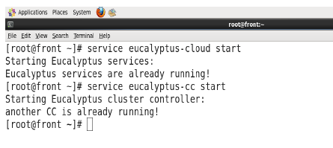
Eucalyptus Private Cloud
Cloud and Cluster Start

Slide 32
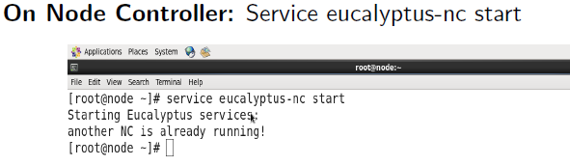
Eucalyptus Private Cloud

Slide 33
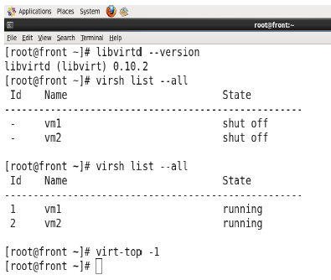
Eucalyptus Private Cloud

Slide 34
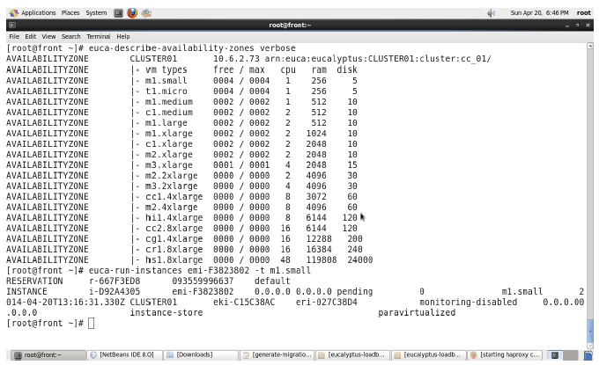
Eucalyptus Private Cloud

Slide 35
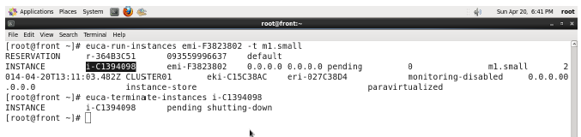
Eucalyptus Private Cloud

Slide 36
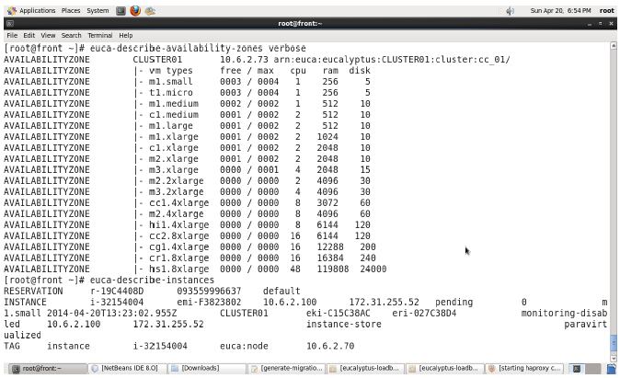
Eucalyptus Private Cloud

Slide 37
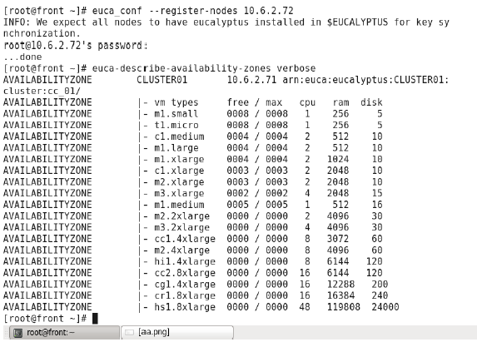
Eucalyptus Private Cloud

Slide 38
Some IaaS Offerings from Public Clouds :

Slide 39
Platform as a Service (PaaS)
User can develop, deploy, and manage execution of applications using basic capabilities offered under IaaS model.
But it is very complex to do so due to lack of platform and required tools.
Platform includes operating system and run time library support.
PaaS provides such platform and enables users to develop and deploy their applications
User application can be developed on virtualized cloud platform using programming languages and software tools such as Java, Python, . NET, RUBY, Perl, R, Hive etc…

Slide 40
Platform as a Service (PaaS)
The user does not manage the underlying cloud infrastructure.
The cloud provider facilitates to support the entire application development, testing and operation support.
Enables third party to provide software management, integration and service monitoring solutions
Cloud services offered under PaaS model includes Google App Engine, Microsoft Azure, and Manjrasoft Aneka

Slide 41
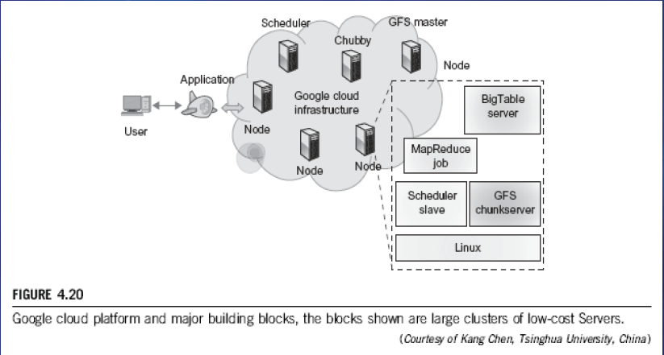
Google App Engine (GAE) Platform as a Service (PaaS)

Slide 42
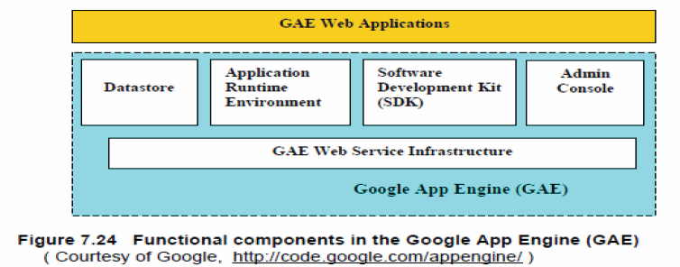
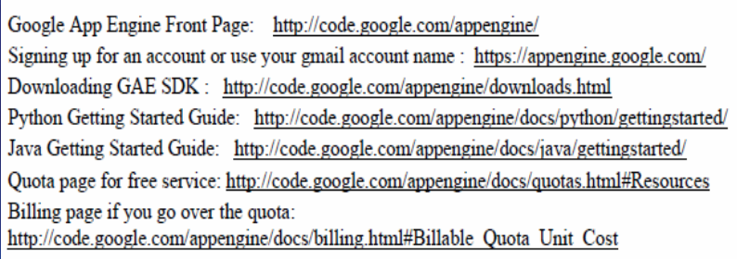
Google App Engine (GAE) Platform as a Service (PaaS)

Slide 43
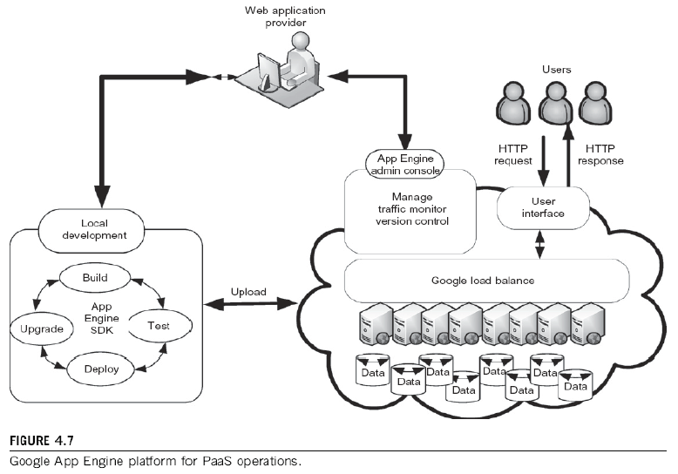
Google App Engine (GAE) Platform as a Service (PaaS)

Slide 44
Example for Platform as a Service (PaaS)
Google App Engine
Web applications are running on a Google’s server cluster.
Application has features such as automatic scaling and load balancing which are convenient for building applications.
Google provides fully featured local development environment that simulates GAE in developer’s computer.
All functions, and application logic are implemented locally. Coding and debugging are performed locally.
SDK provides a tool for uploading the user’s application to Google Infrastructure.

Slide 45
Microsoft Windows Azure Platform as a Service (PaaS)
Windows Azure offers a cloud platform built on Windows OS and based on MS virtualization technologies.
All cloud services can interact with traditional MS software applications such as Windows Live, Office Live, Exchange Online, SharePoint online, Dynamic CRM online.
The Azure platform applies the standard web communication protocols SOAP and REST

Slide 46
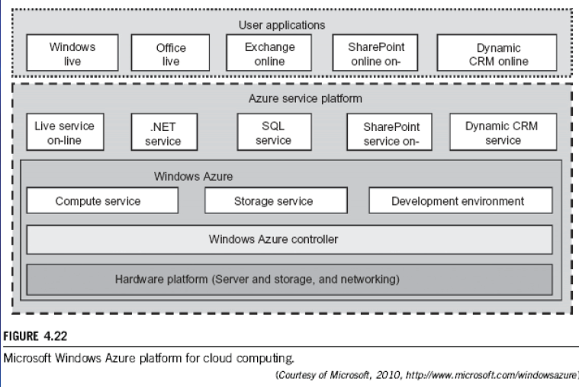
Microsoft Windows Azure Platform as a Service (PaaS)

Slide 47
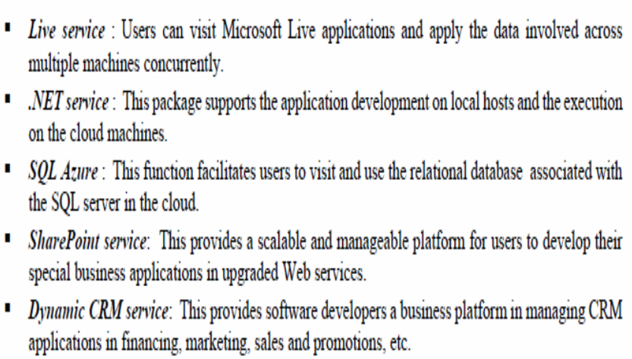
Microsoft Windows Azure Platform as a Service (PaaS)

Slide 48
PaaS Offerings from Public Clouds

Slide 49
Software as a Service (SaaS)
This refers to browser-initiated application software over thousands of cloud customers.
Services and tools offered by PaaS are utilized in construction of applications and management of their deployment on resources offered by IaaS providers.
SaaS model provides the software applications as a service.
As a result, on the customer side, there is no upfront investment in servers or software licensing.
On the provider side, costs are rather low, compared with conventional hosting of user applications.

Slide 50
Software as a Service (SaaS)
Examples: Google Gmail, Google Docs, Microsoft online sharepoint and CRM software from Salesforce.com
Providers such as Google and Microsoft offer integrated IaaS and PaaS services.
Amazon and GoGrid offer pure IaaS services and expect third parties PaaS providers such as Manjrasoft to offer application development and deployment services on top of their infrastructure services.

Slide 51
Cloud Platforms and Services

Slide 52
Cloud Computing as A Service
[9]

Slide 53
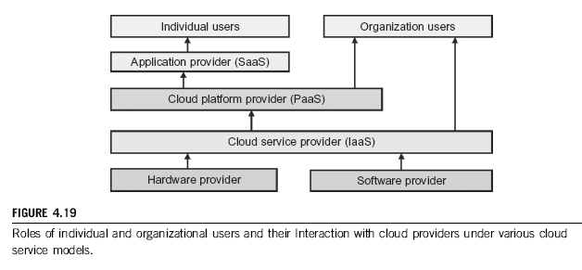
Public Clouds and Service Offerings

Slide 54
Challenges in Cloud Computing (1)
Concerns from The Industry (Providers)
Replacement Cost
Exponential increase in cost to maintain the infrastructure
Vendor Lock-in
No standard API or protocol can be very serious
Standardization
No standard metric for QoS is limiting the popularity
Security and Confidentiality
Trust model for cloud computing
Control Mechanism
Users do not have any control over infrastructures

Slide 55
Challenges in Cloud Computing (2)
Concerns from Research Community :
Conflict to legacy programs
With difficulty in developing a new application due to lack of control
Provenance
How to reproduce results in different infrastructures
Reduction in Latency
No specially designed interconnect used
Very low controllability in layout of interconnect due to abstraction
Programming Model
Hard to debug where programming naturally error-prone
Details about infrastructure are hidden
QoS Measurement
Especially for ubiquitous computing where context changes

Slide 56
Security and Trust Barriers in Cloud Computing
Protecting datacenters must first secure cloud resources and uphold user privacy and data integrity.
Trust overlay networks could be applied to build reputation systems for establishing the trust among interactive datacenters.
A watermarking technique is suggested to protect shared data objects and massively distributed software modules.
These techniques safeguard user authentication and tighten the data access-control in public clouds.
The new approach could be more cost-effective than using the traditional encryption and firewalls to secure the clouds.
56

Slide 57
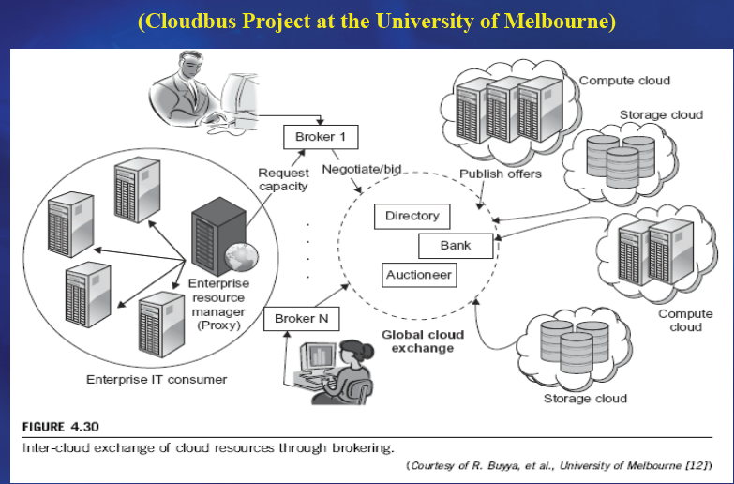
Inter-Cloud or Mashup Services

Slide 58
Summary
Cloud Deployment Models
Public Cloud
Private Cloud
Hybrid Cloud
Community Cloud
Cloud Ecosystem
Cloud Service Models
Infra-structure as a Service (IaaS)
Platform as a Service (PaaS)
Software as a Service (SaaS)
Cloud Computing Challenges

Slide 59
References
R. Buyya, J. Broberg, A. Goscinski (Eds.), Cloud Computing: Principles and Paradigms, Wiley Press, 2011
Cloud Computing Tutorial, www. thecloudtutorial.com, January 2010.
David Lloud Johnson and Daniel Vucci. Auto scaling and cloud bursting service for Eucalyptus. In Virtualization and cloud computing technologies Fall 2011.
Eucalyptus Private Cloud.
http://www.eucalyptus.com/eucalyptus-cloud/get-started
5. Amazon Elastic Compute Cloud. http://aws.amazon.com/ec2

Slide 60
THANK YOU
SSN

